Slide 1
Secure Data Hiding in Image Using Steganography
Presented By : Shubham Vijay Markal
College Name & Department : Hi-tech Institute of Technology.
B-Tech (cse).

Slide 2
OUTLINE
Problem Statement
Technology used
Wow factor
End users
Result
Conclusion
Git-hub Link
Future scope

Slide 3
Problem Statement
With the rise of digital communication, ensuring the security of sensitive information is crucial.
Traditional encryption methods make messages obvious targets for interception.
Steganography allows for secure data hiding within images, making the message undetectable to unauthorized users.
This project explores an efficient method to embed and extract hidden messages within images securely.

Slide 4
Technology used
Programming language used : python (3.12.1) .
Libraries used :
Cv2 : The cv2 library (OpenCV) is used for image and video processing, including reading, modifying, and saving images, as well as applying filters, detection, and transformations
os : The os library in Python is used for interacting with the operating system, including file handling, directory management, and executing system commands
String : for performing string Operations.
Platforms or other tools used : python idle , various ai tools (chat gpt, Claude ai etc.)

Slide 5
Wow factors
High Security : Data is hidden within images, making it invisible to unauthorized users.
Simplicity : Easy to implement and understand using basic Python and OpenCV.
Practical Application : Useful for secure communication in journalism, defense, and cybersecurity.
Password Protection : Ensures only authorized users can retrieve the hidden message

Slide 6
End users
Cybersecurity Professionals : Securely exchange sensitive data.
Journalists & Activists : Protect confidential communications.
Government & Defence : Hide classified information in digital media.
General Users : Ensure privacy in personal messaging.

Slide 7
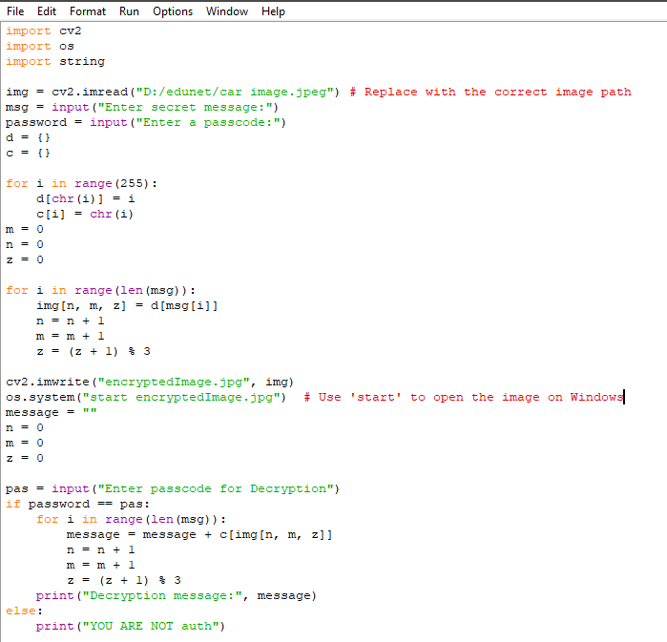
Results
Encryption : The text message is embedded into an image using pixel manipulation.

Slide 8
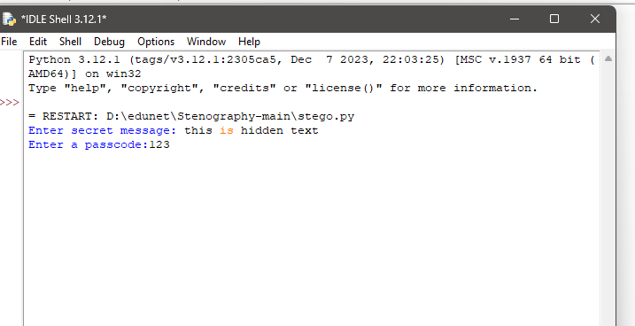
Results
Decryption : The hidden message is retrieved only with the correct passcode.

Slide 9
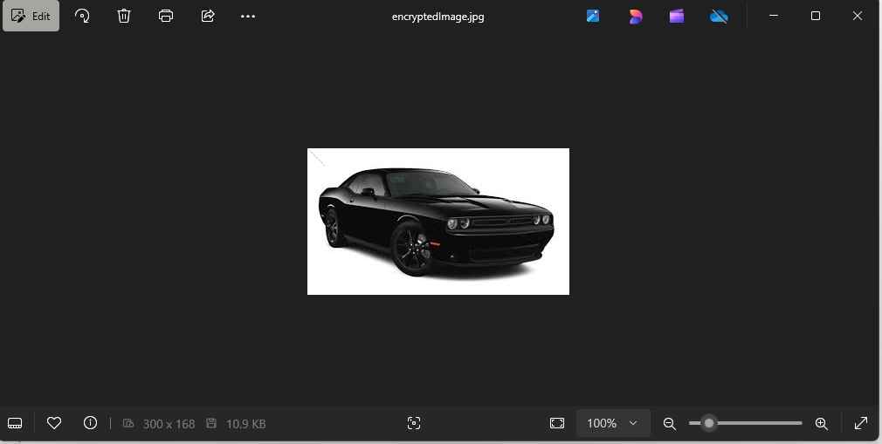
Results
Output : The modified image (encryptedImage.jpg) is generated and can be shared securely.

Slide 10
Conclusion
Steganography provides a powerful method for securing confidential data by embedding it within images.
This project demonstrates a simple yet effective way to hide and retrieve secret messages using Python and OpenCV.
With password protection, the system ensures only authorized users can access hidden information, making it a valuable tool for secure communication.

Slide 11
GitHub Link
Here is the GitHub link :
https://github.com/HemanSensei/steganography_project.git

Slide 12
Future scope
AI-Powered Steganography – AI can make data hiding smarter and harder to detect.
Quantum-Secure Steganography – Future cryptography will use quantum technology for unbreakable security.
Cloud-Based Steganography – Hidden data in cloud images can ensure secure communication.
IoT & Smart Devices – Steganography can help IoT devices send covert alerts and data.
Text & Video Steganography – Future techniques will hide data in text, PDFs, and live videos.
Better Anti-Detection Techniques – Advanced methods will make hidden data completely undetectable.

Slide 13
THANK YOU

